Slide 1
VIP 2.0
Team Members:
Tiago Moore, Victoriano Vega, Steven Rowe,
Jorge Perez, Andres Villa, Miguel Conde, Rodolfo Viant Product Owner:
Masoud Sadjadi Instructor:
Masoud Sadjadi
School of Computing and Information Sciences Florida International University
Senior Project Final Presentation Spring 2016
3/7/2016
Notes:
Greet your audience, thank them for attending your presentation, introduce yourself, introduce your project, introduce your team members, and quickly indicate what each of you did in a high-level manner, and put more emphasis on your part/contribution.

Slide 2
Problem Definition
Our Project
Mobile Judge is a web application that is built more for mobile devices to be the primary use. Mobile Judge is the application that judges will be using to score students during the senior project showcase.
Current Problems
Lacked the ability to accept/reject grades
View/update user profile page
Ability for admin to filter email selections
Social media account linking
Pagination on all grids
Export grades/judges
Import Students
Manage Student/Judges information
My Part
Admin being able to filter judges and students when sending emails
Admin able to Manage student and judges information (Assisted)
Notes:
Introduce the problem that the whole project tackles and stay focused on the parts that you have been working. Indicate if there is an existing previous system, enumerate its problems/limitations, etc.

Slide 3
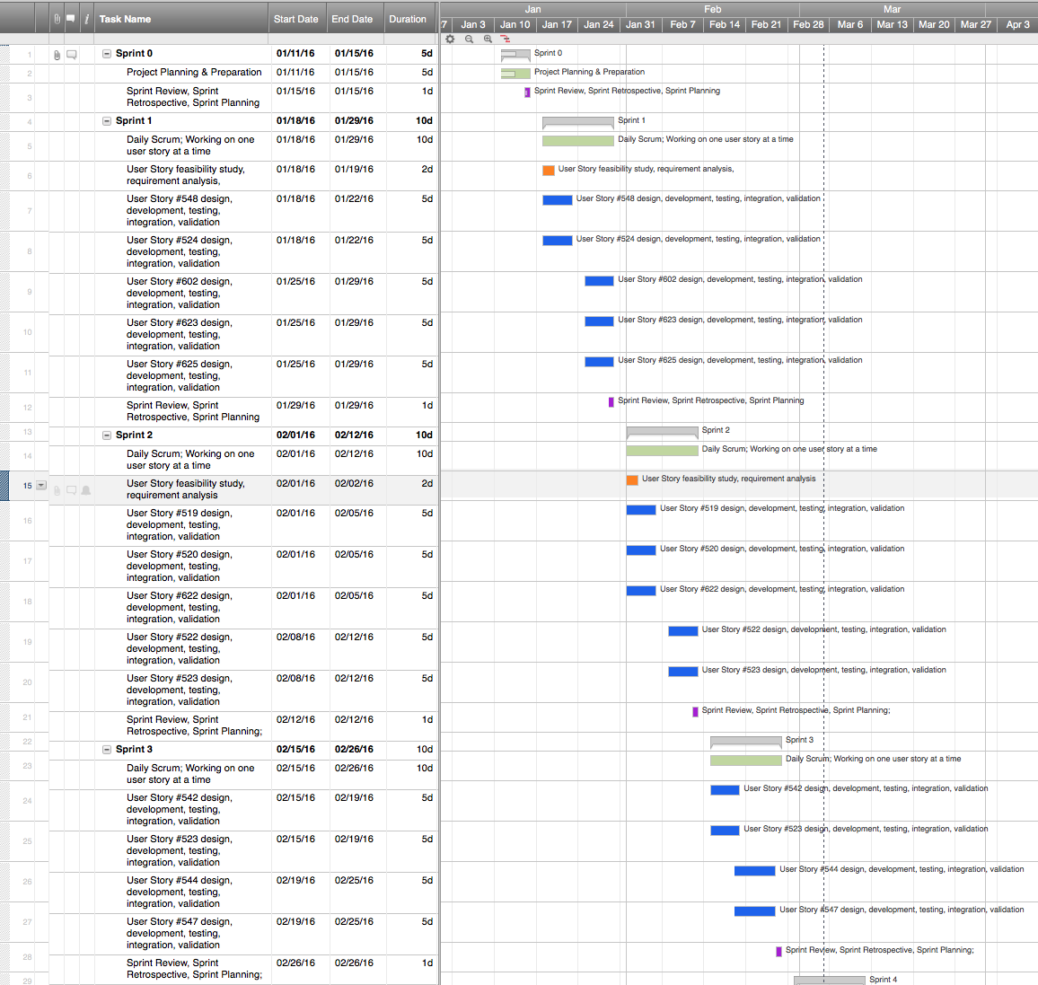
Project Management
Notes:
Project Management (schedule for entire semester) (one slide; Gantt Chart).

Slide 4
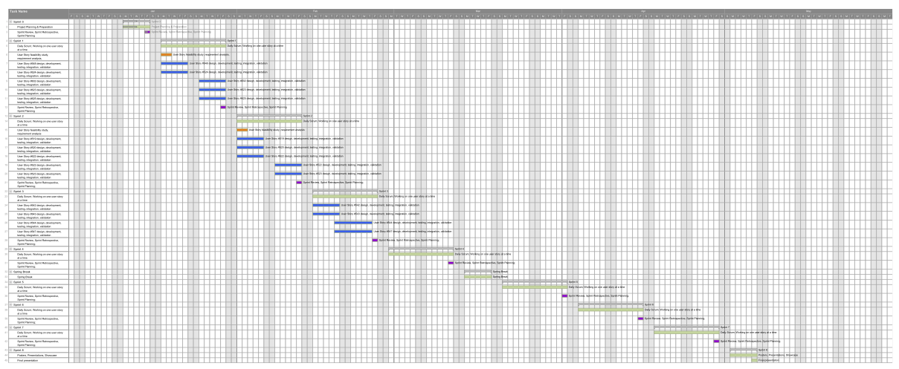
Full Gantt chart

Slide 5
User Stories Implemented
#523-Add Search Feature to Email Wizard
#543-Manage Judges (Assisted)
#544-Manage Student (Assisted)
Notes:
4. Requirements:
4.1. User stories implemented (one or more slides).
4.2. UML use cases and the use case diagram for the implemented use cases (one or more slides).
4.3. UML sequence diagrams for the implemented use cases.

Slide 6
Requirements: Add Search Feature to Email Wizard
Description:
As an admin, I want to search for a name when using the email wizard tool.
Acceptance Criteria:
Search bar will be same style as the one in People tab.
The search bar is available in Step 2 of the wizard.
The admin should be able to choose all students in Step 1, for example, and then in Step 2, he/she can filter some names, unselect them, and then go to the next step.
It should always keep track of the selections in Step 2, no matter what the filter currently shows.
If the user goes back to Step 1, the user should be warned that the changes made in Step 2, if any, will be lost. If there is no changes in Step 2, no need for such a warning.
Notes:
4. Requirements:
4.1. User stories implemented (one or more slides).
4.2. UML use cases and the use case diagram for the implemented use cases (one or more slides).
4.3. UML sequence diagrams for the implemented use cases.

Slide 7
Use Case Diagram
#523-Add Search Feature to Email Wizard
Notes:
4. Requirements:
4.1. User stories implemented (one or more slides).
4.2. UML use cases and the use case diagram for the implemented use cases (one or more slides).
4.3. UML sequence diagrams for the implemented use cases.

Slide 8
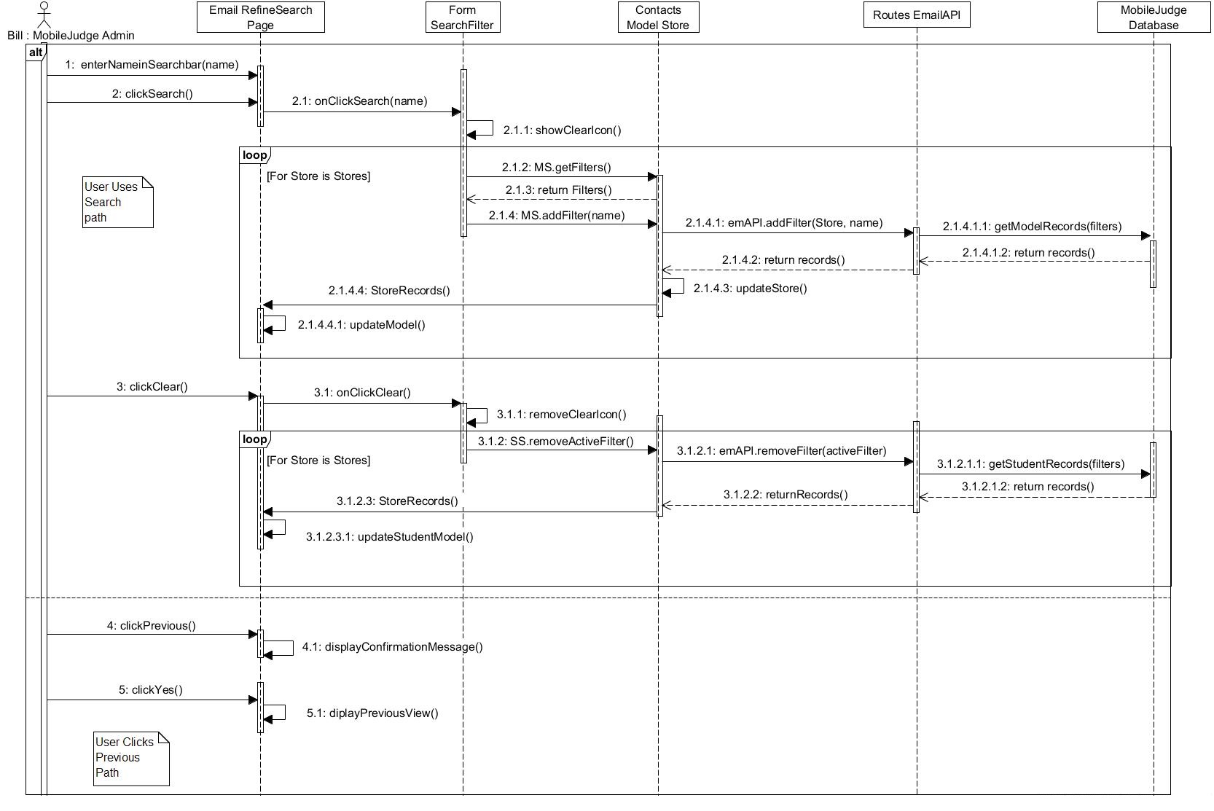
Requirements: Sequence Diagrams
Notes:
4. Requirements:
4.1. User stories implemented (one or more slides).
4.2. UML use cases and the use case diagram for the implemented use cases (one or more slides).
4.3. UML sequence diagrams for the implemented use cases.

Slide 9
Algorithm: Admin Searches for Judge/Student
Apply searchFilter(filter) {
Display clear Icon
For Store in stores
{
Fetch Store.filters
Append (filter, Store.filters)
Fetch records(store.filters)
updateStore(records)
Update Model
}
Notes:
4. Requirements:
4.1. User stories implemented (one or more slides).
4.2. UML use cases and the use case diagram for the implemented use cases (one or more slides).
4.3. UML sequence diagrams for the implemented use cases.

Slide 10
System Design: Architecture
3-tier architecture and Client-Server
Defined and implemented the architecture for VIP 2.0
Security/Privacy
Oauthd authentication
Hashing and salting of passwords
Sanitizing user input
Token based authentication (bcrypt)
Notes:
5. System design:
5.1. System decomposition; identify the architecture patterns used (one slide).
5.2. System deployment – h/w and s/w requirements (one slide).
5.3. Persistent data design (one slide).
5.4. Security/Privacy (one slide).

Slide 11
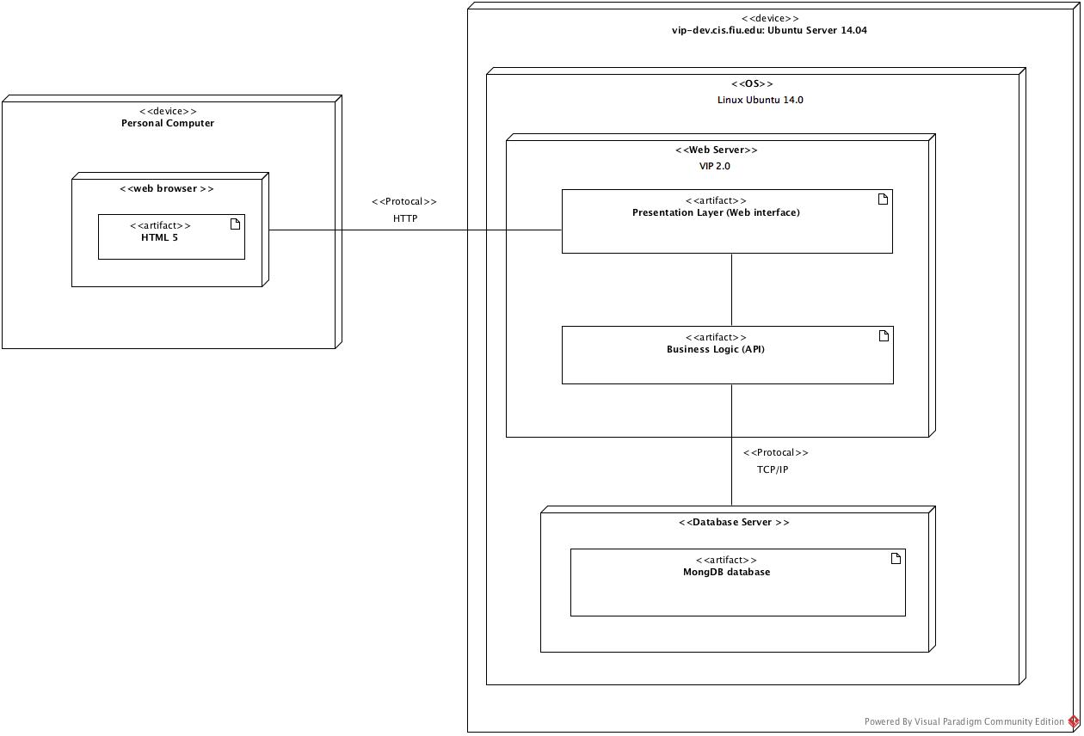
System Design: Deployment
Notes:
5. System design:
5.1. System decomposition; identify the architecture patterns used (one slide).
5.2. System deployment – h/w and s/w requirements (one slide).
5.3. Persistent data design (one slide).
5.4. Security/Privacy (one slide).

Slide 12
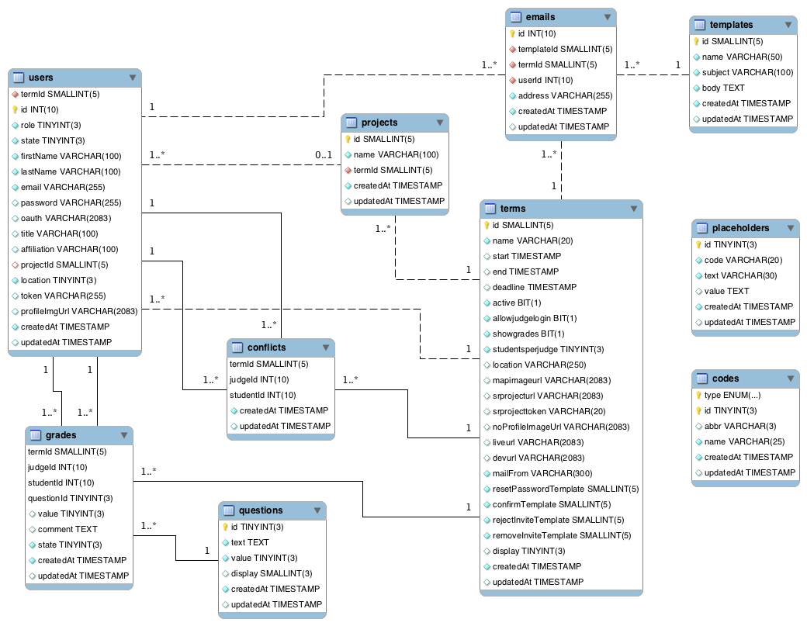
System Design: Persistent data design
Notes:
5. System design:
5.1. System decomposition; identify the architecture patterns used (one slide).
5.2. System deployment – h/w and s/w requirements (one slide).
5.3. Persistent data design (one slide).
5.4. Security/Privacy (one slide).

Slide 13
Minimal Class Diagram
Notes:
6. Detailed design:
6.1. Minimal class diagram. Identify the design patterns used (one or more slides).
6.2. State machine for the main control object or the most important object of the implemented uses cases (one or more slides).
6.3. Main algorithm used related to an implemented use case described above (one or more slides).

Slide 14
Test Suites and Test Cases
Sunny Day
ID: MJ-SD-523-01 Purpose Test if Student name is found on valid search Precondition User has logged on mobile judge User is on the second tab of the email Wizard Input User types in name in the search bar and clicks enter with students grid open Expected Result Grid returns Student record that name matches search criteria The student record must be selectable Text “(must be cleared to proceed to next) should appear in red, bold color/font Next button is disabled Actual Result Grid returns Student record that name matches search criteria The student record is selectable Text “(must be cleared to proceed to next) appears in red, bold color/font Next button is disabled
Notes:
7. Test Suites and Test Cases (one sunny day and one rainy day) for the use case represented in part (5) above (2 slides).
7.1 One sunny day and one rainy day for the implemented use cases (one or more slides).
7.2 Automated test scripts for the implemented use cases (one or more slides).

Slide 15
Test Suites and Test Cases
Rainy Day
ID: MJ-SD-523-06
Purpose Test if clicking no on warning message removes message box without navigating user Precondition User has logged on mobile judge User is on the second tab of the email Wizard User has clicked previous button and warning message is displayed Input User clicks on No button Expected Result User is not navigated to previous tab and message box disappears Actual Result User is not navigated to previous tab and message box disappears
Notes:
7. Test Suites and Test Cases (one sunny day and one rainy day) for the use case represented in part (5) above (2 slides).
7.1 One sunny day and one rainy day for the implemented use cases (one or more slides).
7.2 Automated test scripts for the implemented use cases (one or more slides).

Slide 16
Summary
Improving functionality for all users in Mobile Judge (Admin, Judges, and Students) and setting the groundwork for the VIP website.
Contact information:
Miguel Conde email: Mcond005@fiu.edu
Notes:
Summarize your contribution
Include your contact information
Ask if anyone has any questions for you.
Thank your audience

